Slide 1

Welcome!
First Steps to Financial Security
A Financial Education Course
Brought to you by:
Notes:
The entire First Step Financial Security education session by Southern Bancorp consisting of Money, Credit and Debt management sessions can be presented as a single day seminar, which would last for one and half hours. This session is meant to provide overview or introduction of the topics mentioned. Individuals needing in depth financial counseling can contact …….

Slide 2

First Steps to Financial Security
Covered Topics
Money Management
  Basic Budgeting
  Banking Services
  Checking
  Savings
  Taxes (with-holding)

Slide 3
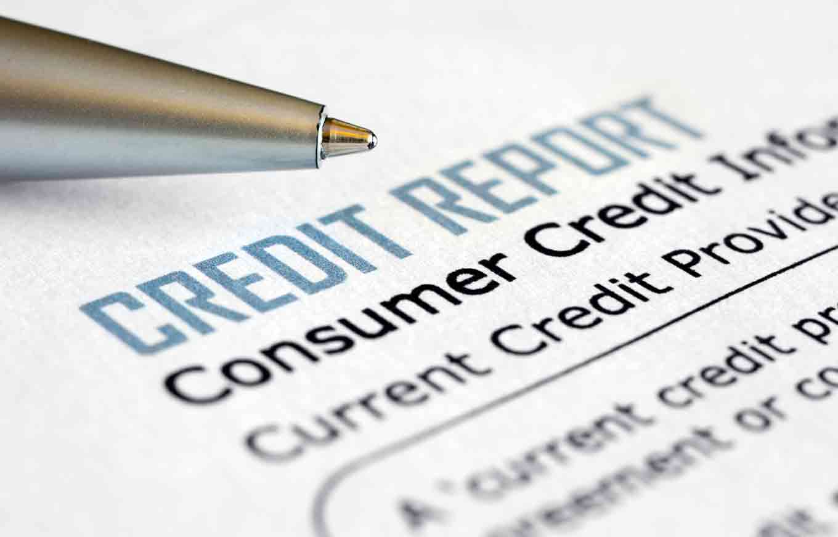
First Steps to Financial Security
Covered Topics
Credit Management
  Understanding credit /history
  Use of Credit
  Establishing/Rebuilding Credit
Debt Management
  Types of debt
  Debt repayment plan

Slide 4
First Steps to Financial Security
Money Management – Basic Budgeting
Identify Wants vs. Needs
Convert income and expenses to monthly amounts
Write it down (paper or electronic budget forms)
Build an emergency fund
Balance your budget by increasing income, reducing expenses, or both
Track your spending

Slide 5
First Steps to Financial Security
Money Management – Rebalancing your budget
Life changes = Budget changes
Changes in income, expenses or goals
“Zeroing Out” –
Money In (income, gifts, etc.) = Money Out (bills, savings, etc.)
Credit counseling agencies can help you get on and stay on track
Use available tools for easy updates

Slide 6

First Steps to Financial Security
Money Management – Checking Accounts
Bank safe and smart with a bank or credit union
Sign up for direct deposit of paychecks and other checks
Avoid fees by using checks or online bill pay for bills
Use a debit cards to make purchases or get cash, even where checks are not accepted
Overdraft Coverage: Do you need it?

Slide 7
First Steps to Financial Security
Money Management – Savings Accounts
Separate your savings from your spending
Protect your savings with an FDIC/NCUA-insured savings account
Create separate savings accounts for each major goal
Pay yourself first with automatic deposits/transfers from checking
Earn interest to build your savings
Notes:
Savings accounts at banks and credit unions are insured by the federal government for up to $250,000.
The financial institution pays you interest on the money you have in a savings account.
You can make deposits into your account and withdraw money when you need it.

Slide 8
First Steps to Financial Security
Money Management – Short Term Savings
Traditional savings accounts
Money Market Accounts (MMAs)
Certificates of Deposit (CDs)
Matched Savings Accounts (Individual Development Accounts)
U.S. savings bonds
Notes:
- CDs sold by banks and some brokerage companies are insured by the FDIC up to $250,000 per depositor.
- CD rates vary widely, but are usually higher than rates paid on savings accounts.
IDAs can help participants:
- pay for post-secondary education
- obtain job training
- buy a home
- start their own business

Slide 9
First Steps to Financial Security
Money Management – Advantages of Checking/Saving
Your money is safe and insured
Bank records provide proof of bill payment
Bank records help track spending
Money in a savings account grows by earning interest
Less expensive than check-cashing stores and money orders

Slide 10
First Steps to Financial Security
Money Management – Tax Tips
Stay organized all year – collect paperwork in one safe place.
Adjust your Form W-4 anytime during the year
Don’t wait until April to deal with your tax return
Know what is deductible
Think twice about paying your taxes with a credit card
Notes:
Before paying taxes with a credit card, check with your credit card company.

Slide 11
First Steps to Financial Security
Money Management – Tax Tips
File return or extension request by April 15th
Pay owed taxes by April 15th to avoid late fees
Earned Income Tax Credit (EITC) – Do you qualify?
Consider VITA for free tax prep assistance
Avoid Refund Anticipation Loans (RALs)
Notes:
To get an extension, you must submit a simple extension form (Form 4868) electronically or by mail. However, this is only an extension to file your return, not an extension to pay what you owe. You still must pay what you owe by April 15. If you don’t penalties and interest charges will be added onto your unpaid portion of your tax.
The Earned Income Tax Credit is a valuable credit for low-income workers. You MUST file a return to get the credit
The following options are available to you
Pay as much as you can with your taxes
Complete form 9465, Installment Agreement Request to request that you make installment payments on the taxes you owe
Call IRS at -1800-829-1040 before April 15 to request for 120 day payment option
Refund Anticipation Loan (RAL) is money borrowed by a taxpayer from a lender based on the taxpayer’s anticipated income tax refund
Refund Anticipation Check (RAC) which directs the refund to a financial institution which disburses fees and the balance to the taxpayer. The IRS is in no way involved in or responsible for RAL (www.irs.com)

Slide 12
First Steps to Financial Security
Credit Management – Credit Management
Using credit responsibly
Understanding your credit history
Establishing and/or rebuilding credit

Slide 13
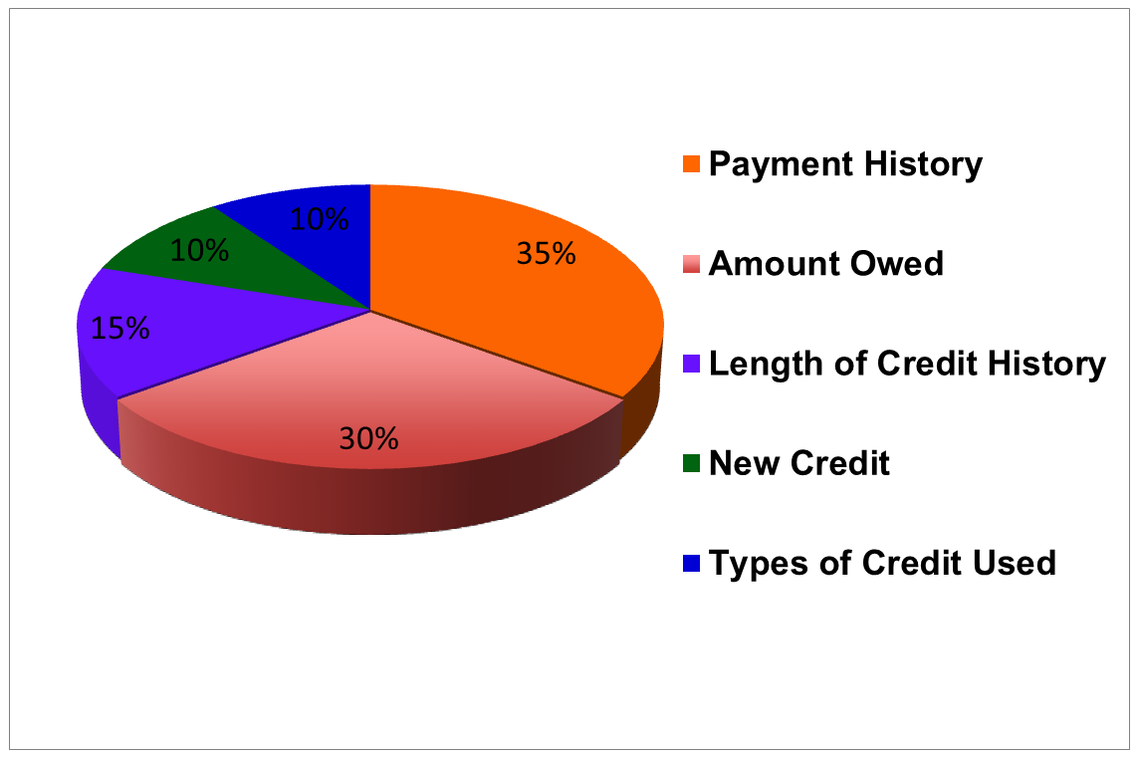
First Steps to Financial Security
Credit Management – Determining your credit score
  Resource: http://www.experian.com/consumer-products/credit-score.html
Notes:
FICO Scores range from 300 up to 850, and average scores fall between 670 and 680. The median FICO Score is 710. Many credit scoring models exist, each with its own unique calculation, because different lenders may require customized scoring models when evaluating and assessing your creditworthiness for their specific offer.

Slide 14
First Steps to Financial Security
Credit Management – Credit Use
Good credit can help with:
Employment
Insurance
Utilities and mobile phone service
Paying for purchases over time
Home Rental
Achieving major goals such buying a home or starting a business

Slide 15
First Steps to Financial Security
Credit Management – Establishing/Rebuilding Credit
Pay at least the minimum payment by the due date
Pay all bills on time
Avoid using more than 50% of each credit line
Make up past-due payments
Don’t accumulate debt
Avoid penalties, late fees and interest rates
Apply for new credit only as needed
Check your credit reports each year (www.annualcreditreport.com)

Slide 16
First Steps to Financial Security
Credit Management – Establishing/Rebuilding Credit
Ask your bank or credit union
Apply for credit with a local company
Sign-up for a retail credit card
Find a co-signer
Sign-up for a secured credit card
AVOID pawn shops and payday loans

Slide 17

First Steps to Financial Security
Debt Management
Types of Debt
Debt repayment plan

Slide 18
First Steps to Financial Security
Debt Management – Types of Debt
Secured (e.g. mortgage, car)
Unsecured (e.g. student loans
Revolving (e.g. credit cards)
Installment (set number of payments)

Slide 19
First Steps to Financial Security
Debt Management – Debt Repayment Plan
Write down all of your debts
Add up all of your minimum payments
Choose a debt repayment plan that works for you.
  Focus on payment with smallest balance (snowballs)
  Focus on payment with highest interest rate (avalanches)

Slide 20
First Steps to Financial Security
Debt Management –Snowballs vs. Avalanches
Debt Snowball
Pay small balances first to create momentum.
Each debt paid off is one less minimum payment to make.
Build confidence by prioritizing “easy” debts first.
Debt Avalanche
Pay highest interest balances first.
Paying highest interest balances saves you money.
Paying highest interest balances saves you time.
(https://www.creditkarma.com/article/how-to-pay-off-your-debt

Slide 21
First Steps to Financial Security
Additional Resources
Money Management
www.treasurydirect.gov
www.savingsbonds.gov
www.irs.gov/VITA
www.fdic.gov
www.ncua.gov
www.idanetwork.org
http://eitcoutreach.org/the-eic-estimator
Credit
Experian: 888-397-3742 www.experian.com
Equifax: 800-685-1111 www.equifax.com
TransUnion: 800-916-8800 www.transunion.com
www.bankrate.com
www.cardtrak.com
www.cardratings.com
www.annualcreditreport.com
Debt
http://www.consumerfinance.gov/credit-cards/knowbeforeyouowe/
http://money.cnn.com/calculator/pf/debt-free/
http://www.hud.gov/offices/hsg/sfh/hcc/hcs.cfm
http://www.consumer.gov

Slide 22
  www.southernpartners.org
First Steps to Financial Security
Congratulations!
You’ve taken the first step toward financial freedom!
Remember that when you focus on your goals, a life of financial security is within reach.
For further assistance, contact your nearest
Southern Bancorp Community Partners credit professional
by calling (800) 789-3428.

Slide 23
First Steps to Financial Security
Thank you.
SouthernPartners.org

